Slide 1
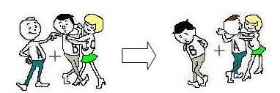
What do you observe

Slide 2




Single Displacement Reactions:
In this type of reaction, a more reactive element displaces a less reactive element from its salt solution
A + XY --> AY + X
In this equation, A, X, and Y are elements and XY and AY are compounds.

Slide 3
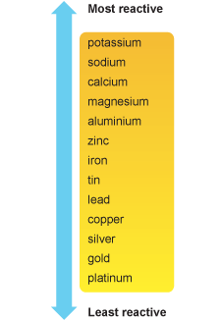
Metal Reactivity Chart
Most reactive metal wins out
H

Slide 4
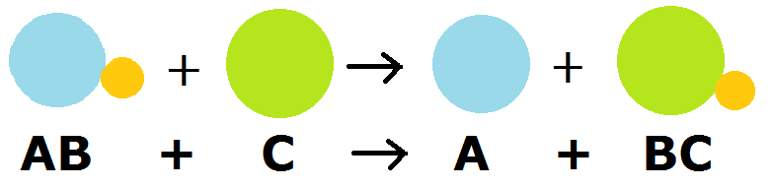
Examples of
Single Displacement Reactions:
2Al + 3Fe(NO₃)₂ → 3Fe + 2Al(NO₃)₃
Zn + CuCl2 → Cu + ZnCl2
Fe + Na3PO4 → N.R.
2K + ZnCl2 → 2 KCl + Zn

Slide 5
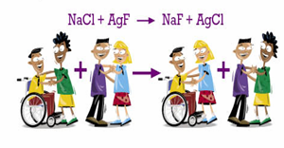
What do you observe

Slide 6
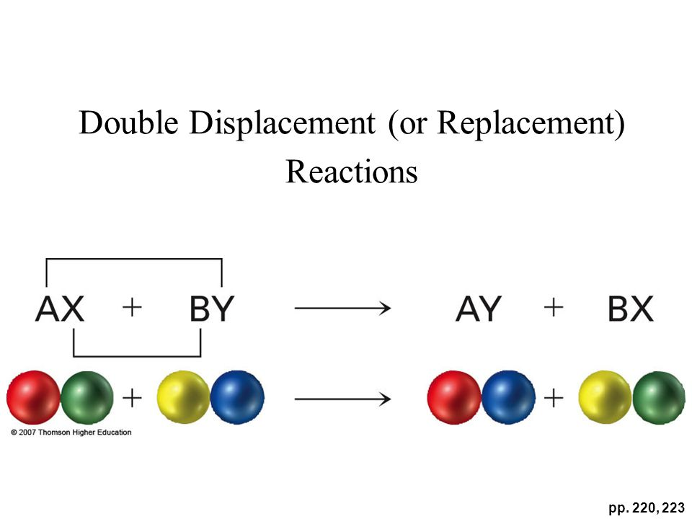
Double-Displacement Reactions:
In a double-displacement reaction, the two compounds exchange places in a solution to form two new compounds.
AB + XY --> AY + XB
2 compounds → 2 new compounds

Slide 7
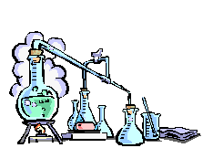
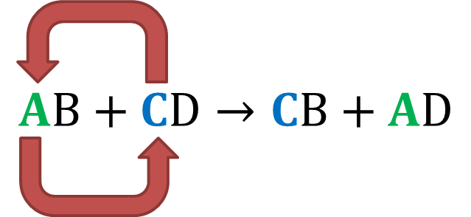
Examples of
Double-Displacement Reactions:
Pb(NO₃)₂ + 2KI --> PbI₂ + 2KNO₃
FeS + 2HCl --> H₂S + FeCl₂
HCl + NaOH --> NaCl + H₂O
”

Slide 8


Combustion Reactions:
When a substance combines with oxygen releasing a large amount of energy in the form of light and heat, it is a combustion reaction.
Oxygen is needed to Burn things.
C + O2 → CO2 + heat

Slide 9

Examples of
Combustion Reactions:
Examples of combustion reactions
C₃H₈ + 5O₂ --> 3CO₂ + 4H₂O + heat
2CH4 + 4O2 → 2CO2 + 4H2O + heat

Slide 10
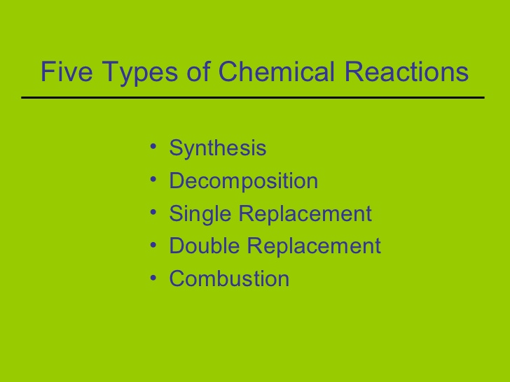

Slide 11

THANK YOU

